Slide 1
Home
Home
Home
See the Timetables
GMIS Website
GMIS Website
GMIS Website
Trade Center
Trade Center
Trade Center
Go to the Canteen!
Time Tables
Time Tables
Time Tables
Get your Timetable!
Canteen
Canteen
Canteen
Sitemap
Sitemap
Sitemap
Visit the Trade Centre
Login/Register
Login/Register
Login/Register
Login
Login
Login
Register
Register
Register
Search
Search
Search
Logout
Logout
Logout
reCAPTCHA

Slide 2
Grade 9 A
Grade 10 A
Grade 11 A
Grade 12 A
Grade 9 B
Grade 10 B
Grade 11 B
Grade 12 B
Grade 9 C
Grade10 C
Grade 11 C
Grade 12 C
Grade 9 D
Grade 10 D
Grade 11 D
Grade 12 D
Grade 9 E
Grade 10 E
Grade 11 E
Grade 12 E
Grade 9 F
Grade 10 F
Grade 11 F
Grade 12 F
Grade 9 G
Grade 10 G
Grade 11 G
Grade 12 G
New Items
My Items
Grade 9 H
Grade 10 H
Grade 11 H
Grade 12 H
Books
Add Item
Clothes
Electronics
Buy
Others

Slide 3
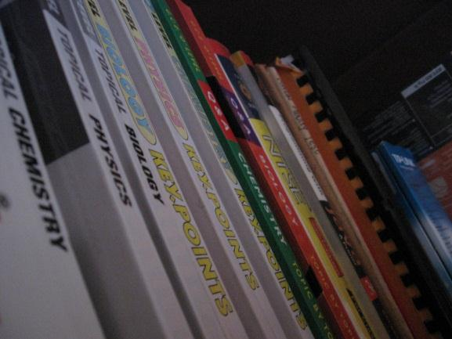
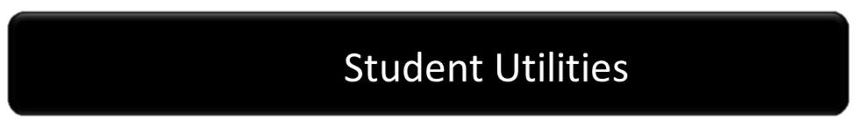

Grade 9
Grade 10
Grade 11
Grade 12
Student Utilities

Slide 4


Slide 5
SU

Slide 6







Blue Shop
Gelato Mania
Kosi – Kosi
Citra
(Mie Shop)

